Slide 1
Multi-threaded Applications
IN710 OOSD 2017
Session 13.1

Slide 2
Threads
Thread
Independent instruction stream
Execution
Single core: Time-slicing
Multiple core: Separate threads can run in true parallel
Notes:
All the applications we have written have been single threaded (at least as far as our code goes; the Operating System has been threading all along…)
We can also write code where we explicitly launch execution in separate threads.
Multiple threads are executed “simultaneously”.
With a single core, the processor time-slices between low level commands (for example, modifying the data value in a register).
First one thread’s commands, then switches to another’s, then switches again.
As each processing thread requires many low-level commands, the threads are, effectively, being executed simultaneously.
This is how windows always works, btw. Take a look at the Task Manager and you will see most applications have multiple threads, and all running threads are being serviced via time-slicing.
In a multi-core machine, you can have true simultaneity.

Slide 3
Writing Multithreaded Apps
Advantages
Performance improvement
Enhanced UI responsiveness
Disadvantages
Processor overhead
Synchronisation failures
Difficult to debug
Subject to disastrous, unpredictable malfunctions
Notes:
Performance improvements especially when some processes are very slow
With single threading, everyone waits for them
With multi-threading, useful work can be done by other threads while we wait for the slow ones
Of course, the slowest thing in a computer system is usually the user, so multi-threading can be especially valuable here
Also for data access, peripheral access, remote stuff, and so on.
Synchronisation failures occur when two threads access the same data and their operations get interleaved. For example, if you test a variable then change it, there is time between those two statements where another process could sneak in and modify the data, nullifying the results of the test.
In fact, the risks are so great that I toyed with the idea of not teaching them at all.
Two things changed my mind

Slide 4
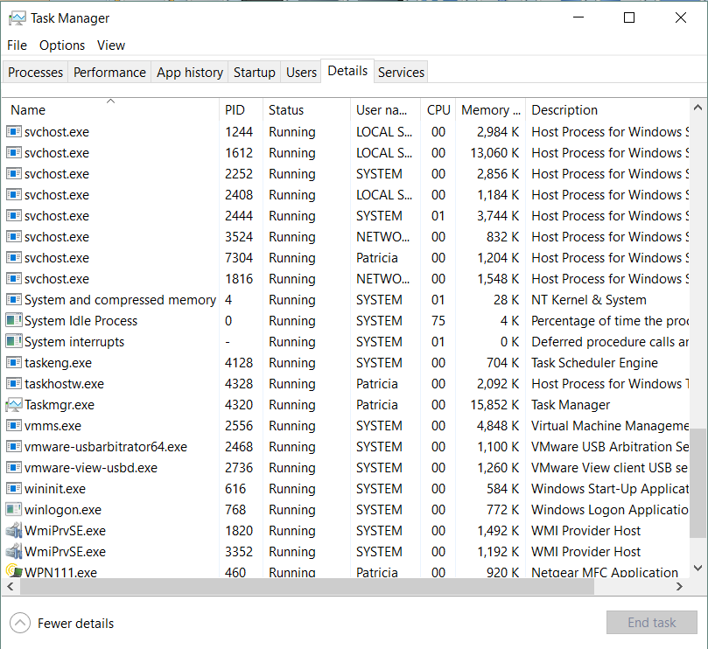
Motivation
Notes:
Nearly everything is multi-threaded

Slide 5
Motivation
In any serious application, there will be multiple threads. Even "boring" applications like MS Office.
Multi-threading is HARD. It's HARDER to get right. Students need to know what the critical issues are.
IMO one of the key differences between a good graduate and a poor graduate is whether they run screaming at the sight of a multi-threaded application. There are very, very, very few applications that can be written to a commercial standard without the use of threads.
Notes:
Comment from a professional programmer…
So we will look at Threading.
It is not possible to cover the topic in-depth in this course – that could easily be an entire course on its own
But we will look at the basic issues, and the basic techniques available in .NET
That should enable you to learn what you need to learn when it comes up on the job
It will also allow you to consider the role threading (along with events, of course) might play in your implementation of the major project

Slide 6
When to Consider Using Threads
When the application performs some slow task that can run in the background while other processing continues.
Complex calculations
Web service
Remote database work
Notes:
The other processing is often UI
Even if the main thread can’t do anything useful while waiting, it can still respond to mouse and keyboard events or run a cursor animation so that the user doesn’t think the application has hung.

Slide 7
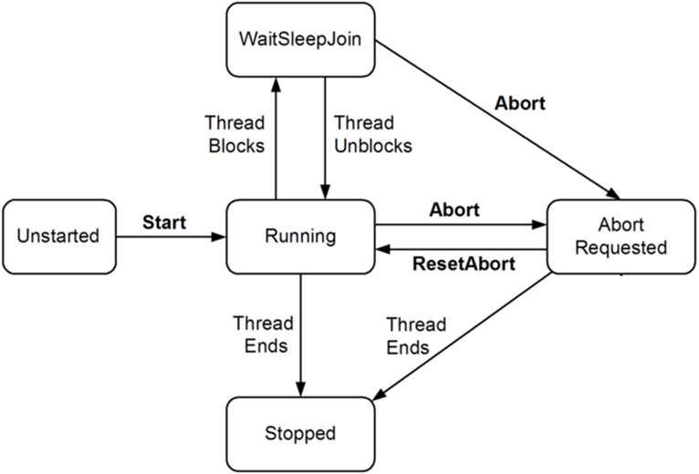
Thread States
Notes:
This is one of three state diagrams for Threads. The actual state of a thread is the factorial of the three
One – suspend/resume – is deprecated, so we will ignore it.
The second – foreground/background – only effects the impact of threads on application termination, and we will ignore it as well, considering only foreground threads. This just means that the app will not terminate until all threads have terminated.
So this is the FSM of interest.
Unstarted : Thread object defined (involves a delegate…) but not yet started running
Running: Wants cycles. Will do work when it gets them
WaitSleepJoin: The thread blocks. Paused for one of three reasons
Is blocked. We will see how this happens. Generally waiting for a particular event to occur, or for access to resources.
Has received a sleep command
Has been told to Join (i.e. wait for the termination of) another Thread
Aborted and Stopped: Killed or in the process of being killed. Note that once a thread is Stopped or Aborted, it can’t be restarted.
So running, paused, or terminating.
When running, it wants its share of the CPU’s attention.

Slide 8
Thread Execution
Via time-slicing
Every thread has its own stack for local variables
All threads belonging to the same process share the heap
Communication between threads via data can be very fast
Communication between threads via data can be very dangerous
Notes:
But this shared heap thing is complicated: can be good, can be bad.
A managed .NET thread may or may not map directly to an operating system thread.
This is not our problem

Slide 9
Low-Level Threading
System.Threading.Thread
Notes:
We are going to look today at fundamental low-level thread management, as this is the best way to get a clear understanding of what is really going on in a concurrent execution situation.
Next time, we will look at modern .NET multi-threading, which is done via wrappers and extensions to the core system methods.

Slide 10
Creating Threads
The Thread class constructor:
Thread(ThreadStart startDelegate)
ThreadStart delegates return void and take no arguments
The method bound to the delegate instance is the code you want the thread to execute.
Notes:
If you could see the constructor of the Thread class, it would take a delegate of delegate type ThreadStart.
The ThreadStart delegate type method signature is: returns void, takes no arguments
We will see how to pass data to thread methods in a little bit
There is a more complex type that takes an Object. We will see it later. Usually, we use this one.

Slide 11
Creating Threads
ThreadStart ts = new ThreadStart(appropMethod);
Thread t = new Thread(ts);
t.Start();
Notes:
The syntax is straightforward…
Assume an appropriate method (void and null)
Create a delegate of type ThreadStart.
Create a Thread object, passing in that delegate
When you create the Thread with its constructor call, you now have a thread in the unstarted state
To start it, call Start();
It enters the running state

Slide 12
Example
public class Worker
{
public void DoWork()
{
// do whatever needs to be done
}
……
Notes:
Assume we have this class.
Note that DoWork() has the correct method signature to become a ThreadStart delegate.

Slide 13
Example
Worker threadWorker = new Worker();
ThreadStart ts = new ThreadStart(threadWorker.DoWork);
Thread t = new Thread(ts);
t.Start();
Notes:
Assume the Worker class is visible from where we are..
Now we can do this…
Note that, as with delegates, if a class has static methods, it is not necessary to create an instance first.
However, we will see that, with Threads, we usually want to create an instance.
Why do you think this is?
Because the ThreadStart delegate can accept no data arguments, we will need some way to get the data into the guy executing the thread.
The most straightforward way is to set up a class instance with the required data, then thread its worker method.
That’s why we usually create instances.
We will see examples.

Slide 14
Shortcut Syntax
Worker threadWorker = new Worker();
Thread t = new Thread(threadWorker.DoWork);
t.Start();
Notes:
It is important that you understand the role of the ThreadStart delegate (we will see further the role of delegates in all this as we proceed), but there is actually a shortcut syntax for creating Threads that saves some typing, and this is the one we will usually see in the wild.
You just stick the method name into the Thread constructor. The compiler infers the delegate creation for you.
There are actually even more compact options that this, but they become unreadable, so we will ignore them

Slide 15
Identifying Threads
Set the thread’s Name property
Access the currently running thread as Thread.CurrentThread
t.Name = "worker1";
………
Console.WriteLine(Thread.CurrentThread.Name);
Notes:
Essential in debugging, otherwise you can’t tell who is working when things happen
So you set the name, then later you write the name
Note the console here.
We will be doing a little console programming when we first start working with threads
This is because handling form controls like ListBoxes as we usually do for output is a little complex when multi-threading.
We will cover it, but not until a bit later on.
If you don’t remember Console programming, don’t worry, we will review.

Slide 16
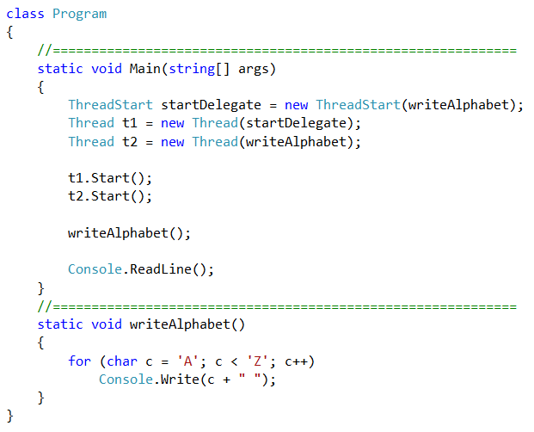
Example
Notes:
Our first threading example…
We’re using the console here, so we’ve created a Console Application, not a Windows Forms Application
Class program is the automatic outer class you get when you ask for a C# console project
Static void main is point of entry
You can’t create instances of class Program (there can only be one), so all its methods must be static.
We create the static method void writeAlphabet()
What happens here?
Make two threads that are going to run writeAlphabet (one the long way, one with the shortcut)
Start them
Then also call writeAlphabet from the main thread
Now there are three versions of writeAlphabet running simultaneously.
What’s the output?

Slide 17
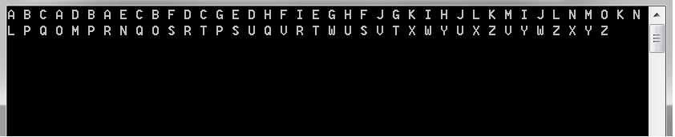
Example
Notes:
You can see where the CPU sliced, but you can’t tell who is doing what.
(NB: I have tweaked this code just a little bit to make more switching (by slowing it down some). If you duplicate this code on your fast machine, there may not be quite so much interleaving.)
Let’s add the names

Slide 18
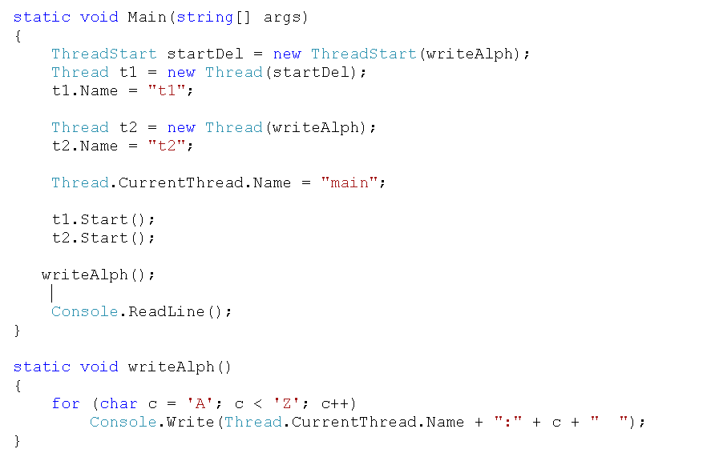
Example
Notes:
Here we have named the threads.
Note how we name the main thread, because it is running
Then in writeAlpha, we stick the name in there, asking for the currentThread AT THAT POINT
Do you see how CurrentThread when we name it main is the main thread, and CurrentThread inside writeAlpha can be any one of the three threads?
What’s the output?

Slide 19
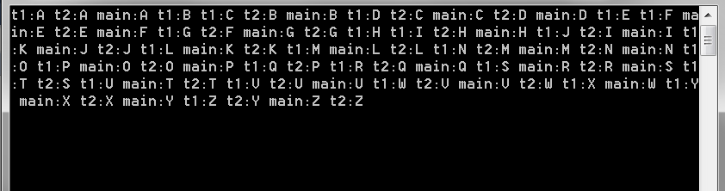
Example
Notes:
Note the interleaving.
Will it be exactly the same every time?
No.

Slide 20
Thread Safety
Problems with threads often occur when two threads share data.
Each thread has its own memory stack space, so local variables are distinct.
But threads share data if they refer to the same object instance.
Notes:
Or global variable.

Slide 21
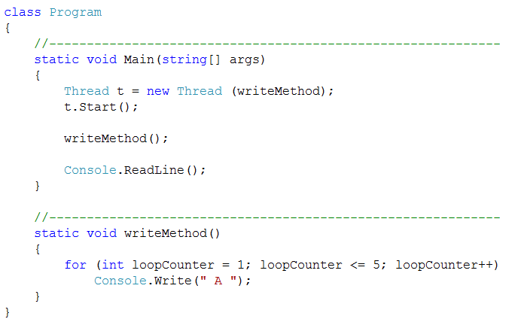

Separate Data
Notes:
Here we have a little worker called writeMethod, which contains a local int loopCounter
This method is going to run twice – once in its own thread t, and once in the main thread
Both threads have a for loop variable called “loopCounter”. Is there any problem with one guy incrementing the other guy’s loopCounter?
No.
Because loopCounter is local, and each thread has its own stack space, the two versions of loopCounter are completely distinct, so there is no problem with one thread’s for loop incrementing the other thread’s counter.
The output is 10 A’s, as shown

Slide 22
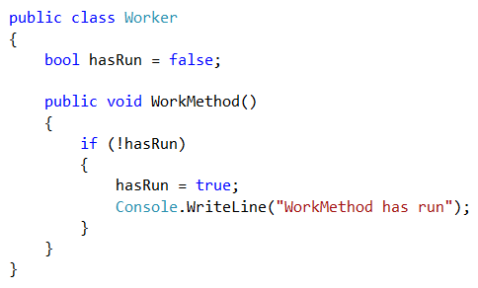
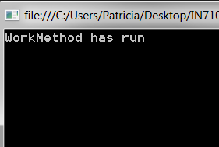
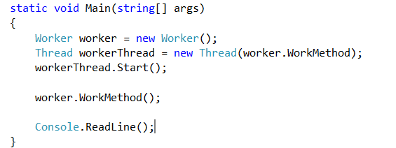
Shared Data
Notes:
However, if two threads use the same non-local object, things can get awkward...
Look at this code.
We might use something of this structure if we had a multi-threaded app, and there was some method that we wanted to make sure was run only once, across the whole app (this is the Singleton pattern), but which could potentially be launched from various places (e.g. Depending on different user input).
There is a little worker class with a boolean flag and a simple method.
In the method, it checks the flag. If the flag hasn’t been set, the method generates output, then sets the flag.
So the method should only run one time for a given application execution.
We are going to run this method in two threads: the main (via a direct call), and a created one (via a ThreadStart delegate).
Note that the method is not static, so we need to create an instance to get access to the method in order to delegate and thread it.
Since the two threads are using the same instance to build the delegate and make the direct call, they use the same copy of hasRun.
As expected then, the first guy to run sets the hasRun flag, and so the second doesn’t do the write – the method only runs once.

Slide 23
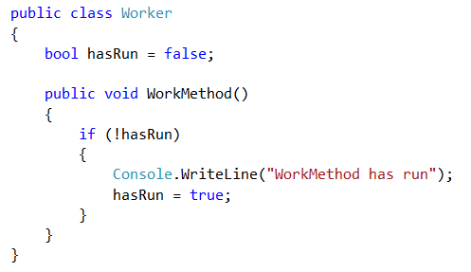
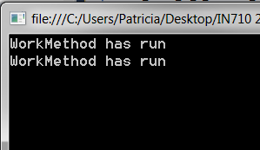
Shared Data
Notes:
Imagine, however, that we changed the worker class like this....
All we have done here is changed the order of the two statements in the if
Now the program output is as shown (most of the time)
Now the second thread is able to get into the if block, even though the first thread has written, and should have set the flag.
Why is this?
The WriteLine is slow. In between when the first thread starts and finishes its writeline and changes the hasRun flag, the second thread sometimes has time to evaluate the if (!hasRun). This is still true, so it goes ahead and does the writeline.
We should be agreed that whether a piece of conditional code is executed once or twice should not depend on the order of the statements. That could be a nasty bug to track down.
This is the scary part of multi-threaded coding.
We will see later how to insure that your threaded code is safe. That is, it runs atomically – the same as though all threads had run in serial.
(NB: If your machine is very fast, you might not see this effect with this example. But the problem will occur as soon as you start trying to do things that take more time than writing to the console, e.g. file system or database access.)

Slide 24
Providing Data to Threads
ParameterizedThreadStart(object o)
Use instance data:
Define a class
Give it the data properties needed
Give it the worker method you want to thread
Make an instance
Set the data values
Thread it
Notes:
We now want to look at how to pass data to threads.
Since the ThreadStart delegate accepts no args, we can’t do it there.
We have two options:
First you can use the alternative delegate ParameterizedThreadStart
It accepts one argument of type object, which must be cast
As indicated by the name, this form is most useful for a worker method that runs in one of a number of states/flavours and you decide which based on the parameter. See the docs for details.
The second method, which is much more flexible, is to use instance data.

Slide 25
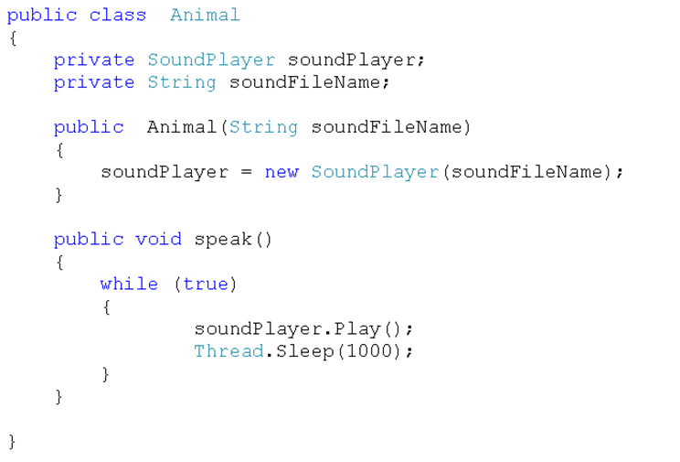
Providing Data to Threads
Notes:
Imagine we want to make a variety of objects that play sounds
We will put them on separate threads
Each thread needs to know what sound it’s making
Speak() is our worker method. An infinite loop that plays the sound.
The sleep just lets the sound finish, because a new call to Play interrupts the current one.
If you make one animal and start it up, and its sound clip < 1000 msec, it will play over and over.
Note that it fits the delegate type required by ThreadStart.

Slide 26
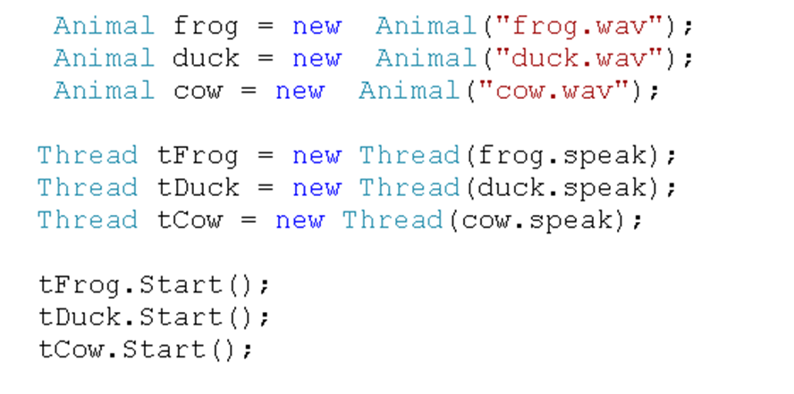
Providing Data to Threads
Notes:
We then can make some sounds like this…
(NB: Remember, no () when you pass the method name in….)
Each Animal will play its own sound file. So we have gotten data into a thread.
So what if we do this?
You might expect to hear the Frog, then the Duck, then the Cow, over and over, but you won’t
The sound output channel is a resource, and all three threads are competing for it, and conflicts will occur.
As the system moves between the multiple threads, the sounds will play in random orders, and they will cut each other off
We will see how to deal with this in a bit.

Slide 27
Killing a Thread
t1.Abort();

Slide 28
Waiting for a Thread to Finish
public void someMethod()
{
// code....code....code
t1.Join(); // will pause here until t1 finishes
// code here executes after Thread t1 has finished
}
Notes:
Any method that says this will pause at that point until thread threadName finishes.
Then it will proceed
This notion of waiting on other threads brings us to the larger topic of coordinating the timing of multiple threads
This is…

Slide 29
Synchronisation 1
If multiple threads access common data, data integrity can be compromised.
bool withdrawMoney(amount)
{
if (balance >= amount)
{
balance -= amount
issue amount in cash
}
}
Notes:
For example, your student record in EBS, or your bank account balance property…
E.G. Imagine this pseudocode scenario at two ATMs (perhaps across town from each other) where two users are accessing the same account at the same time.
With a single thread, nothing can happen to balance between the check (if) and the update (-=)
But with two threads, t1 can read the balance and get true, then it can lose the CPU to t2 who reads the balance and also gets true.
T1 when it gets the cycles back, decrements and issues, but so does t2. The user can get $amount twice, even if there wasn’t that much in the account to begin with.
We need for this not to happen.
System.Threading provides a number of techniques for this.
We will look at the simplest; the remainder are left as an exercise

Slide 30
Synchronisation 1
lock
With the lock function, we can make blocks of code atomic
lock applies to an object
The contended object itself
Another object created solely to be locked
Only one class instance can run the locked code block at a time
Other instances will wait until the lock is released (automatically at the end of the block)
Notes:
“Atomic” means that the block of code won’t be broken into in the middle.
Technically, atomic code is that which, when run in parallel, produces the same output as if it had been run in serial.
The “contended object” is a variable/memory object which multiple threads want to access ( “balance” in our ATM example)

Slide 31
Synchronisation 1
bool withdrawMoney(amount)
{
lock(balance)
{
if (balance >= amount)
{
balance -= amount
issue amount in cash
}
} // lock ends automatically
}
Notes:
Here’s the same code
We wrap the relevant session in a “lock block”
The first thread to reach it executes the lock(balance) command.
Subsequently, any thread that reaches that statement will wait until the lock on balance has been released
That happens automatically at the close bracket
At that point, the next thread in the queue executes the lock statement and proceeds

Slide 32
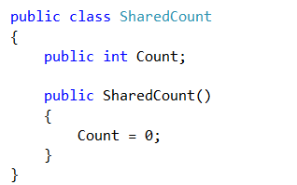
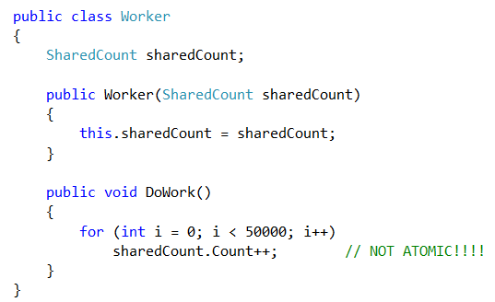
Example
Notes:
We’re going to make a bunch of threads running this DoWork method.
All the Workers will share the same SharedCount object instance
We just let them loop and increment. This simulates whatever complex action that you might want to do.
Think hotel reservations or something.
Note that the increment operation is not atomic. It actually involves three steps: reading the value of sharedCount into a register, incrementing our register copy of that value, then writing the value back out.

Slide 33
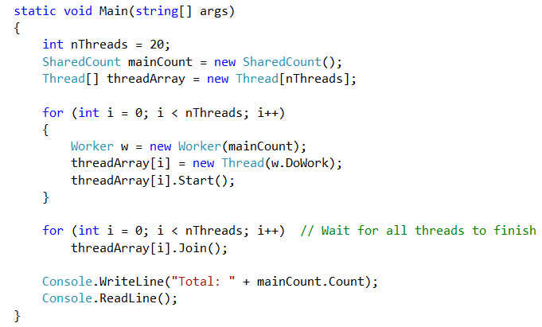
Example
Notes:
Here we will simulate a whole bunch of threads working on that count for awhile.
First we create the shared object
Then we create and start 20 threads all using that object
The second for loop just waits for everyone to finish
What should the answer be?
Recalling that the doWork method runs a 50,000 iteration for loop, we expect: 20 * 50000 = 1000000

Slide 34
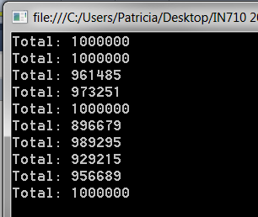
Example
Notes:
Here is output from 10 runs of this program
Sometimes, we get the expected answer, but often, it is less.
How does this happen?
Sometimes, someone reads it and increments it, but before they can write it back, someone else reads the old value.
So that second thread doesn’t see the increment. It reads the unupdated value.
The number they compute and write back is smaller than it should be.
(Note that the exact pattern of outputs you get will vary from machine to machine and from run to run)
What should we do?

Slide 35
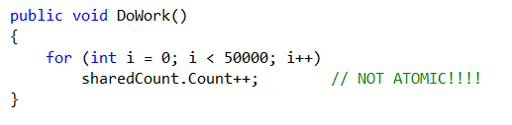
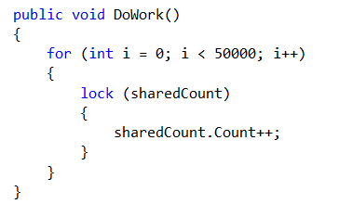
Example
Notes:
This needs to be made atomic.
So, only one thread can be executing this statement at a time
Thus we lock the resource.
(Extra curly brackets for clarity only; they aren’t required for one-statement blocks, as always.)
This means: “You can’t execute the code in this block unless you have the lock on sharedCount”
It doesn’t really matter that it is sharedCount that is locked. Any data object that all the threads can see would work just as well.

Slide 36
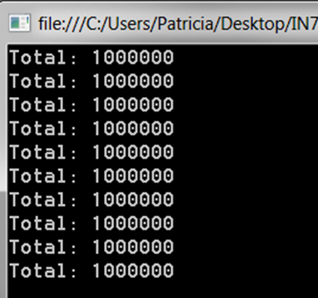
Example
Notes:
This is the output after locking
Much better, eh?
You will notice that the synchronised version runs slower. The price you pay.

Slide 37
Potential Locking Disaster
Thread 1 code locks Obj1 and then Obj2
Thread 2 code locks Obj2 and then Obj1
Each thread gets its first lock….
…and then waits for its second lock
Notes:
This is called a deadlock.
Try to avoid it.
In database systems, they have elaborate logic to deal with deadlock, to try to prevent it, to detect it when it occurs, and to deal with it.

Slide 38
How to Avoid Data Access Conflicts
Don’t share data
But if you must share data, lock carefully
Notes:
But if you must share data, lock carefully
There are more complex locking and synchronisation mechanisms available in .NET for you to explore

Slide 39
Practicals

